Slide 1
Uncertainty as tool to prioritize inventory improvement
Jolien van Huijstee

Slide 2
Inventory improvement
High
Prioritization
Apply share and uncertainty as weights
Significant
Substantial
Uncertainty
Low
Low
High
Share of total emission

Slide 3
Key source analysis
Key source ranking using IPCC Approach 2 level assessment for 2020 NOx emissions
GNFR | 2020 Gg | Share | Uncertainty estimate | Level * Uncertainty | Share L * U | Cumulative Share L * U
L_AgriOther | 30.3 | 14.4% | 120.3% | 17.3% | 40.8% | 41%
I_Offroad | 34.9 | 16.6% | 37.2% | 6.2% | 14.5% | 55%
G_Shipping | 22.7 | 10.8% | 52.2% | 5.6% | 13.3% | 69%
F_RoadTransport | 60.0 | 28.5% | 11.9% | 3.4% | 8.0% | 76%
B_Industry | 28.9 | 13.7% | 20.8% | 2.8% | 6.7% | 83%
A_PublicPower | 13.4 | 6.4% | 38.3% | 2.4% | 5.7% | 89%
K_AgriLivestock | 3.6 | 1.7% | 118.0% | 2.0% | 4.7% | 94%
C_OtherStationaryComb | 14.3 | 6.8% | 29.3% | 2.0% | 4.7% | 98%
H_Aviation | 2.2 | 1.0% | 35.9% | 0.4% | 0.9% | 99%
M_Other | 0.2 | 0.1% | 203.4% | 0.2% | 0.5% | 100%
J_Waste | 0.2 | 0.1% | 104.6% | 0.1% | 0.2% | 100%
E_Solvents | 0.0 | 0.0% | 80.3% | 0.0% | 0.0% | 100%
IIR 2022

Slide 4
Uncertainty analysis – Approach 2
Procedure Monte Carlo simulation (IPCC guidelines, 2006)
Estimation of activity data and emission factors (country specific)
Including uncertainties, probability distributions, correlations (if any)
Random sampling of AD and EF
Calculate emission with random samples
Emission factor * Activity data = Total emission
Iterate step 2 & 3 > Sample size = 10 000
Aggregate sampled emissions to source categories (NFR)
Calculate mean, standard deviation and uncertainty
95% confidence interval: 1,96 * σ (% of mean)
Notes:
To minimize the effect of dependencies between emission factors and/or activity data, the sources categories are aggregated before the monte carlo iteration
for any given confidence interval (e.g., 95% or 90%), it is assumed that the true value of the statistic (i.e., median or mean) will fall within the associated percentiles of the bootstrapped distribution of that statistic. In the case of a 95% confidence interval, the width of the interval would be the difference between the 2.5th percentile and 97.5th percentile

Slide 5
Key source analysis
Key source ranking using IPCC Approach 2 level assessment for 2020 NOx emissions
GNFR | 2020 Gg | Share | Uncertainty estimate | Level * Uncertainty | Share L * U | Cumulative Share L * U
L_AgriOther | 30.3 | 14.4% | 120.3% | 17.3% | 40.8% | 41%
I_Offroad | 34.9 | 16.6% | 37.2% | 6.2% | 14.5% | 55%
G_Shipping | 22.7 | 10.8% | 52.2% | 5.6% | 13.3% | 69%
F_RoadTransport | 60.0 | 28.5% | 11.9% | 3.4% | 8.0% | 76%
B_Industry | 28.9 | 13.7% | 20.8% | 2.8% | 6.7% | 83%
A_PublicPower | 13.4 | 6.4% | 38.3% | 2.4% | 5.7% | 89%
K_AgriLivestock | 3.6 | 1.7% | 118.0% | 2.0% | 4.7% | 94%
C_OtherStationaryComb | 14.3 | 6.8% | 29.3% | 2.0% | 4.7% | 98%
H_Aviation | 2.2 | 1.0% | 35.9% | 0.4% | 0.9% | 99%
M_Other | 0.2 | 0.1% | 203.4% | 0.2% | 0.5% | 100%
J_Waste | 0.2 | 0.1% | 104.6% | 0.1% | 0.2% | 100%
E_Solvents | 0.0 | 0.0% | 80.3% | 0.0% | 0.0% | 100%
IIR 2022

Slide 6
Level of detail
NFR Code | NFR Name | SNAP | SNAP Name | Code | Emission Source
1 A 3 a i (i) | International aviation LTO (civil) | 080502 | International airport traffic (LTO cycles - <1000 m) | 0930005 | Exhaust gas, civil aviation, LTO, Auxiliary Power Units
 |  | 080506 | International airport traffic (LTO cycles - <1000 m)- tyres and brakes abrasion | 0930031 | Civil aviation, LTO, international, Approach
 |  |  |  | 0930021 | Civil aviation, LTO, international, Climb Out
 |  |  |  | 0930041 | Civil aviation, LTO, international, Idle
 |  |  |  | 0930011 | Civil aviation, LTO, international, Take Off
 |  |  |  | 0930008 | Tyre wear, airplanes at airports
 |  |  |  | 0930009 | Brake wear, airplanes at airports
NFR Code | NFR Name | SNAP | SNAP Name | Code | Emission Source
3 D c | Farm-level agricultural operations including storage, handling and transport of agricultural products | 100901 | Anaerobic | 0449300 | Concentrates supply
 |  | 100902 | Liquid systems | 0441430 | Silage storage
 |  | 100903 | Solid storage and dry lot
 |  | 100904 | Other
 |  | 101000 | Farm-level storage, handling and transport of agricultural products
Notes:
SNAP codes

Slide 7
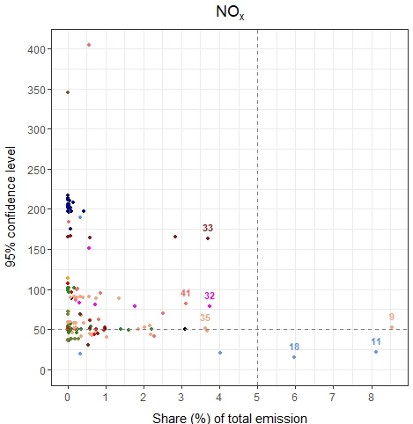
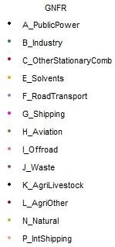
# | NFR Code | Long Name | Emission source | Share | Uncertainty estimate
9 | 1A3di(i) | International maritime navigation | Sailing, NCP, Container ships | 8,5% | 52%
11 | 1A3biii | Road transport: Heavy duty vehicles and buses | Exhaust gas, heavy vehicles | 8,1% | 22%
18 | 1A3bi | Road transport: Passenger cars | Exhaust gas, passenger cars | 6% | 14%
32 | 1A3di(ii) | International inland waterways | Exhaust gas, inland shipping international | 3,7% | 78%
33 | 3Da2a | Animal manure applied to soils | Manure application | 3,7% | 163%
35 | 1A3di(i) | International maritime navigation | Sailing, NCP, Roro cargo/Car ships | 3,6% | 51%
41 | 1A2gvii | Mobile combustion in manufacturing industries and construction | Exhaust gas, mobile machinery - building & construction | 3,1% | 82%
Notes:
Toevoegen: aggregated uncertainty of (G)NFR to show it is not always representative

Slide 8
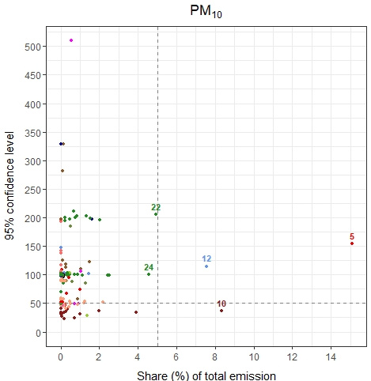
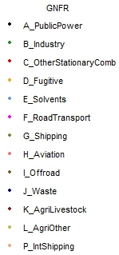
GNFR | Share | Uncertainty estimate
C - Other Stationary Combustion | 17,5% | 139%
E - Solvents | 9,3% | 94,6%
B - Industry | 31,2% | 46,1%
# | NFR Code | Long Name | Emission source | Share | Uncertainty estimate
5 | 1A4bi | Residential: Stationary | Residential combustion, wood stoves and fire places | 15,1% | 154%
10 | 3B4gi | Manure management - Laying hens | Laying-hens, manure in stable and storage excl. NH3 | 8,3% | 36%
12 | 2G | Other product use | Fireworks at new year | 7,6% | 115%
22 | 2A6 | Other mineral products | NACE 23: construction material and glass industry, diffuse | 4,9% | 205%
24 | 2H3 | Other industrial processes | Building and construction sites | 4,6% | 100%

Slide 9
Time for questions

