Slide 1

BC Reporting under the CLRTAP
Dr Chris Dore – Aether
Emily West – Environment Canada
(Robert Wankmueller – CEIP)

Slide 2
Contents
Background and Context
Reported Emissions
Summary of Conclusions/Recommendations
  The Reported Data
  Next Steps

Slide 3

1. Background and Context
Introduction of Voluntary Reporting
Recognition that the expertise within the Convention is suited to the reporting of BC
Revised Gothenburg Protocol and revisions to Reporting Guidelines:
  Allow for the incorporation of voluntary reporting from 2013 onwards
Revision of the EMEP/EEA Guidebook
  Allows for BC EFs to be added.

Slide 4
2. Emissions Reporting
Summary of Data Submissions 2000-2013
Countries Reporting BC
  Canada*, United States**
  Finland, Norway, Sweden
  France, Italy, United Kingdom
  Azerbaijan, Belgium, Bulgaria, Croatia, Cyprus, Denmark, Estonia, Hungary, Ireland, Latvia, Lithuania, Malta, Netherlands, Portugal, Republic of Moldova, Romania, Serbia, and Switzerland.
USA – 405 ktonnes (2011)
Canada & European countries – 209 ktonnes (2011*)
Residential (Stationary) & Passenger Cars – 40%

Slide 5
2. Emissions Reporting
Trends with Time (Large Countries)

Slide 6
2. Emissions Reporting
Source Apportionment

Slide 7
2. Emissions Reporting
Trends with Time (Nordic, European)

Slide 8
2. Emissions Reporting
Source Apportionment

Slide 9
2. Emissions Reporting
Trends with Time (Increases)

Slide 10
2. Emissions Reporting
Source Apportionment –Country Comparison

Slide 11
2. Emissions Reporting
Top 10 NFR Sector account for 77% of total BC emissions.
NFR Longname | NFR Code | Total PM2.5 (kt) | Total Black Carbon (kt)
Residential: Stationary | 1A4bi | 691.41 | 64.81
Road transport: Passenger cars | 1A3bi | 33.64 | 22.49
Agriculture/Forestry/Fishing: Off-road and machinery | 1A4cii | 25.86 | 16.95
Road transport: Heavy duty vehicles and buses | 1A3biii | 25.40 | 16.74
Road transport: Light duty vehicles | 1A3bii | 20.87 | 13.82
Mobile Combustion in manufacturing industries and construction | 1A2gvii | 17.37 | 11.93
International maritime navigation | 1A3di(i) | 54.72 | 8.07
Transport (fuel used) | 1A3 | 10.69 | 4.86
Stationary combustion in manufacturing industries and construction: Other | 1A2gviii | 20.64 | 4.62
National navigation (shipping) | 1A3dii | 22.67 | 4.36

Slide 12
2. Emissions Reporting
BC/PM_{2.5} (as %)

Slide 13
2. Emissions Reporting
1A4bi – Residential BC/PM_{2.5} (as %)

Slide 14
2. Emissions Reporting
1A3bi – Passenger Cars BC/PM_{2.5} (as %)
Gasoline EF’s range from (2-30% of PM_{2.5})
Diesel EF’s range from (10-87% of PM_{2.5})

Slide 15
2. Emissions Reporting
1A4cii – Agricul/Forestry/Fishing NRMM

Slide 16
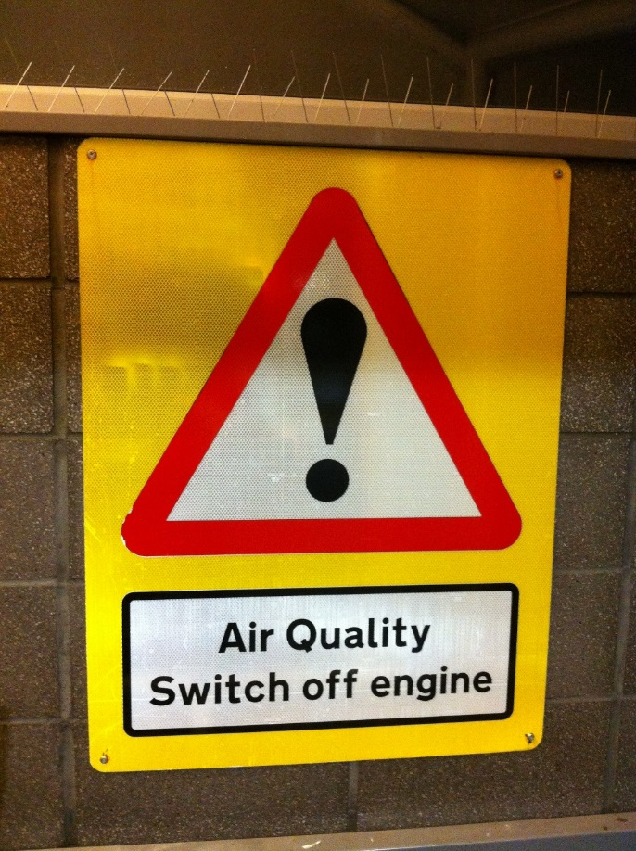
Conclusions/Recommendations
The Reported Data
Good coverage for the first year of voluntary reporting
Some specific gaps are evident
A number of clear trends have been identified
Some questions remain from analysis of source apportionment

Slide 17
Conclusions/Recommendations
The Next Steps
Aim to improve all reporting, but some countries are more important than others!
Development of methodologies and EFs is on-going.
Continued comparisons of CLRTAP vs “research” inventories are important for verification purposes.
TFEIP to strengthen links to other “communities”.
The aim should be that national inventories inform GAINS (not the other way around!).

Slide 18

THANK-YOU FOR YOUR ATTENTION
chrisdore@aether-ukcom
+44(0)1865 261466
www.aether-uk.com

