Slide 1
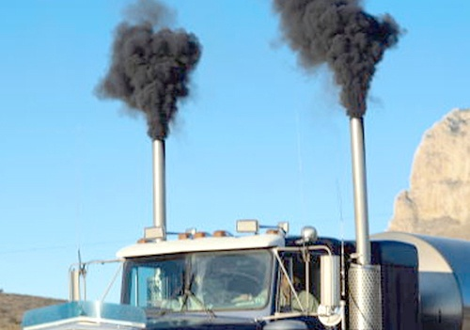
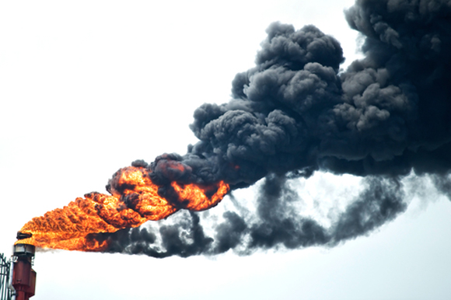
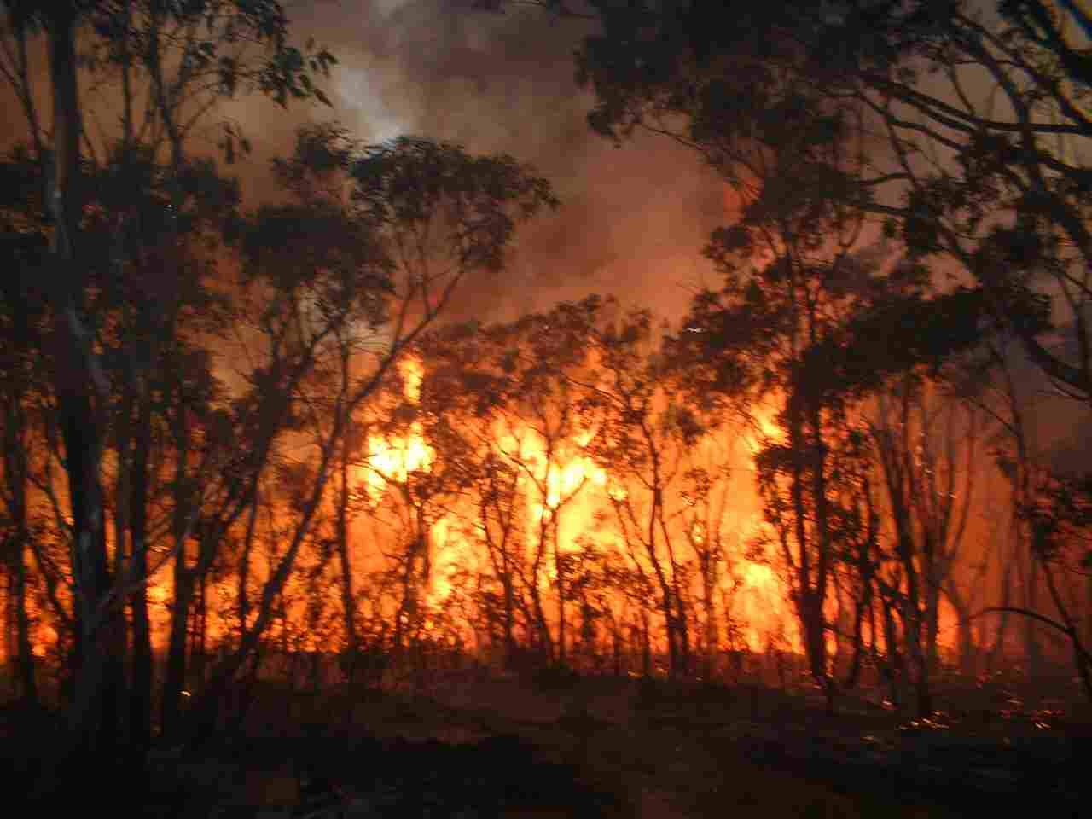
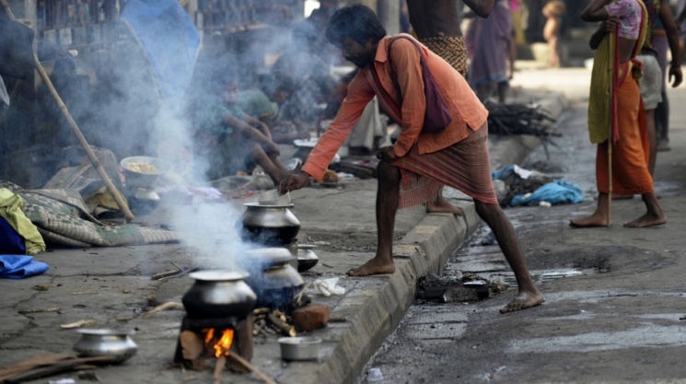
Black carbon in the atmosphere
Some views from an electricity company
Eric Joos (EDF R&D)

Slide 2
BLACK CARBON EMISSIONS FROM COAL-FIRED POWER PLANTS
BC: major part of combustion soot (un-oxidized carbon particles)
Soot results from incomplete combustion of organic matter
The most important reason for incomplete combustion of hydrocarbons is insufficient mixing between fuel, air (oxygen) and combustion products
Coal combustion in furnace of large power plants : pulverized coal, turbulent mixing, low excess air, high temperature
Coal-fired power plants have low emissions of BC (~ 35 mg/GJ for an international bituminous coal i.e. 10 times less than BC emissions from a HFO large boiler)

Slide 3
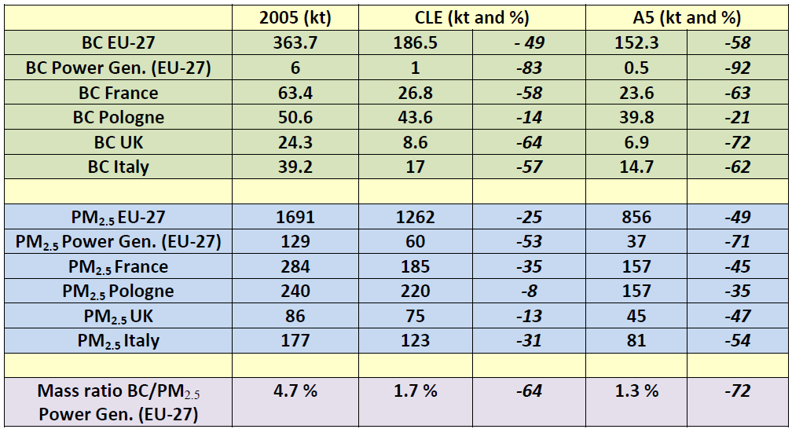
EMISSION INVENTORIES IN THE EU
IIASA simulations of 2025 policy scenarios for the revision of Thematic Strategy on Air Pollution (TSAP Report # 10, March 2013)
BC share of PM_{2.5} : 2.2 % for hard coal; 3.3 % for biomass (EEA/EMEP GB 2013)
PM_{2.5} EF for a coal-fired power plant with wet FGD: 1.5 – 2 g/GJ (bit. coal)

Slide 4
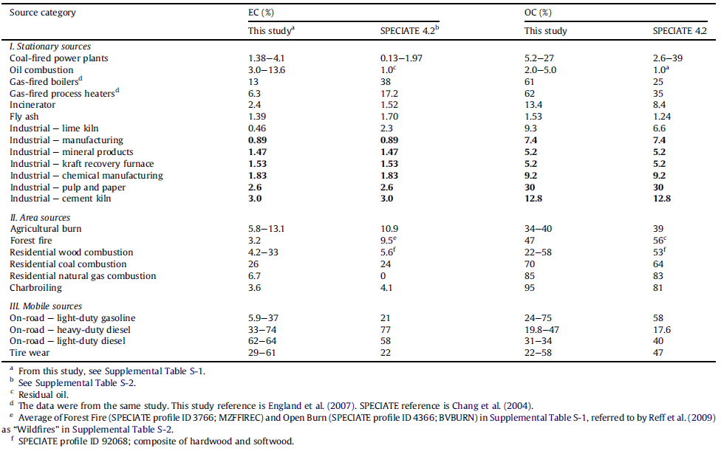
PM_{2.5} source profiles for black and organic carbon emission inventories (Judith C. Chow et al., Atmospheric Environment., 2011)

Slide 5
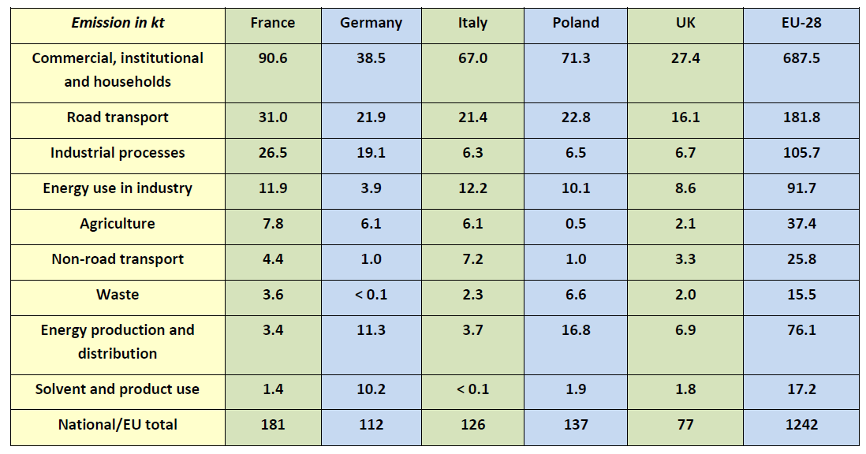
2012 Emission Inventories for PM_{2.5} in the EU-28 (2014 EEA Report – EEA sectors)
Aren’t some values surprising?

Slide 6
Black carbon in ambient air
Average daily concentration: 0.1-0.2 µg/m³ in rural areas to 1-5 µg/m³ in cities like Paris or London. Values > 10 µg/m³ near curbside or in polluted cities (e.g. in China)
Adverse impact on human health (inhalation): may not be a major directly toxic component of fine PM but may operate as a carrier of a wide variety of combustion derived chemical constituents of varyint toxicity to sensitive targets of human body (WHO, 2012)
BC (or EC) concentration in ambient PM_{2.5} is an appropriate particle metric (surrogate) for hazardous risks for human health in urban areas - Proxy for traffic combustion exhaust
Decreasing exposure to ambient PM_{2.5} with BC reduces adverse effects on human health associated with fine PM (WHO)
Ambient aerosol concentrations are calculated by chemical-transport models (CTM - cost-benefit assessments, epidemiologic studies)

Slide 7
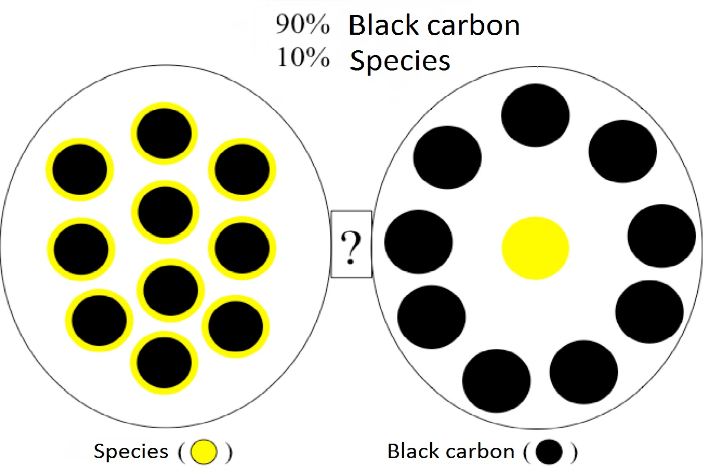
Mixing state of BC
Coatings on BC particles can be formed through condensation and coagulation of low-volatility compounds co-emitted from combustion sources (primary unburned organics) or secondary species like sulfates or nitrates

Slide 8
Aerosol mixing state
CTM usually assume that particles are internally mixed i.e. there is only one chemical composition for a given size section
Under the external mixing assumption, particles in a given size section may have different chemical compositions
Internal-mixing assumption may be realistic far from emission sources but is not valid close to them (local scale)
The mixing state assumption may strongly influence aerosol chemistry and hygroscopic characteristics (secondary organic aerosols, wet diameter, CCN)
Most experimental studies that deal with particle chemical composition vs size are not particle specific (i.e. mixing state not characterized)
A few recent experimental works dealt with mixing state of aerosol particles in urban environment

Slide 9
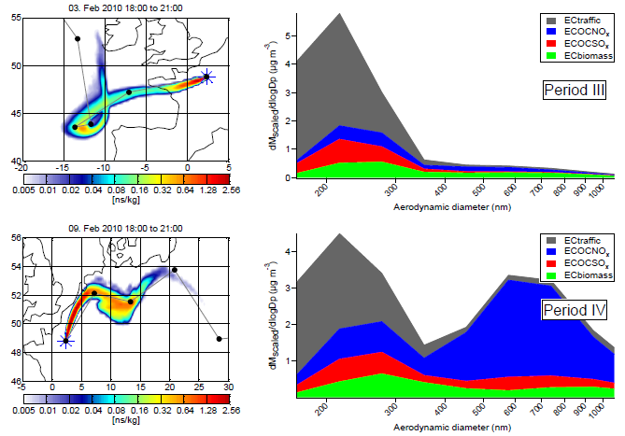
MEGAPOLI 2010 WINTER CAMPAIGN IN PARIS (aerosol time-of-flight mass spectrometer analyses)
R.M. Healy et al., Atmos. Chem. Phys., 12, 1681-1700, 2012
Notes:
4 of the 15 ATOFMS classes identified were assigned as EC-containing

Slide 10
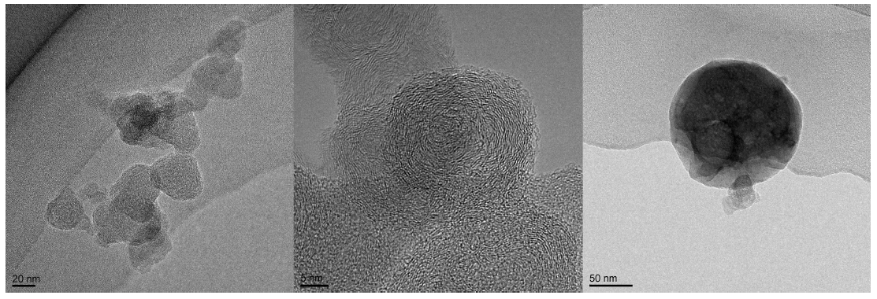
CENTRAL COPENHAGEN – WINTER TIME (transmission electron microscope)
(Left) A TEM image of a typical soot aggregate. (Middle) HR-TEM showing the microstructure of the primary particles of the aggregates. (Right) An image of a typical dense particle.
J. Rissler et al., Environ. Sci. Technol., 48, 6300-6308, 2014

Slide 11
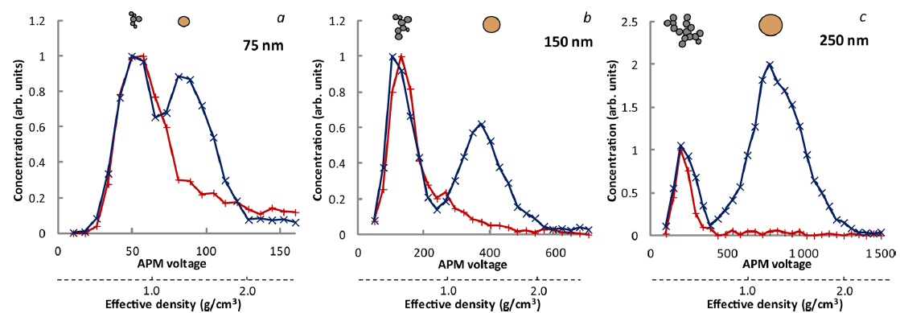
CENTRAL COPENHAGEN – WINTER TIME (diffential mobility analyzer-aerosol particle mass analyzer)
J. Rissler et al., Environ. Sci. Technol., 48, 6300-6308, 2014

Slide 12
Externally mixed particles in CTM
Treatment of aerosol mixing state in CTM considerably increases the computational cost
A model was recently developed by CEREA (joint laboratory Ecole des Ponts Paris Tech – EDF R&D) named SCRAM: Size-Composition Resolved Aerosol Model
All three main processes involved in aerosol dynamics are included: coagulation, condensation/evaporation, nucleation
First box model simulations (0D) were carried out using data representative of air pollution in Greater Paris (S. Zhu et al., Geosci. Model Dev. Discuss., 7, 7938-7987, 2014
CEREA is currently working on the 3D implementation and managed to successfully run 3-D simulations using SCRAM with a reasonable CPU time (paper to come)

Slide 13
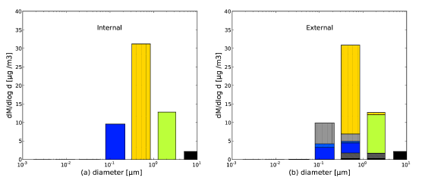
Comparison internal/external mixing with SCRAM model (12h simulations starting just before the morning traffic peak)
Realistic ambient concentrations and emissions extracted for one grid cell of the 3-D simulation performed with CEREA Polyphemus air quality modeling platform over Greater Paris (data from July 2009 MEGAPOLI campaign)
5 chemical groups : hydrophilic organic group (HLO), hydrophobic organic group (HBO), hydrophilic inorganic group (HLI), black carbon (BC), dust (in black, unmixed)
Blue: mixed (HBO dominating) – Pale blue: mixed (HBO and BC dom.) Yellow: mixed (HBO and HLI dom.) – Dark grey: unmixed BC (> 80%) Pale grey: unmixed HBO (>80%) – Green: mixed (HLI dom.)

