Slide 1
Assessment of the CLRTAP Stage 1,2 & 3 Reviews
Dr Chris Dore 11/05/2015

Slide 2
Contents
Approach
Data Collection
Findings – Stages 1, 2
Findings – Stage 3
… Discussion
Acknowledgement:
Our thanks to the EEA for funding this work under the ETC/ACM.

Slide 3
1. Approach
Tasks:
Identify the current stakeholders and consultees
Consultation on stakeholder needs, and whether these are being met
Stakeholder views on other aspects
Detailed expert assessment of Stage 1 and 2
Detailed assessment of Stage 3

Slide 4
2. Data Collection 1/2
High-level Consultation
EMEP Steering Body and technical groups
CLRTAP Implementation Committee
The European Commission
The European Environment Agency
Technical/Detailed Consultation
CEIP
Representatives from national emission inventory teams, and expert reviewers.

Slide 5
2. Data Collection 2/2
Expert Review
Stages 1 and 2 - Expert review of individual tests and routines
Stage 3 – Expert opinion from a lead reviewer.

Slide 6
3. Findings – Stages 1,2
Findings and Recommendations
Not much attention paid to Stages 1 and 2 by many Parties (questions are most useful part)
Generally considered necessary (although results are usually known by the inventory team).
Are the results used for Stage 3?
26 (very detailed) recommendations… but generally recommend kept the same.
Addition of detailed IEF comparisons across countries.
Scope to improve formats/interface.

Slide 7
4. Findings – Stage 3 1/4
Scope of Review
Some countries failing to deliver sufficient material
No time to consider “all” pollutants
No link to the Implementation Committee
Some recommendations are subjective (“NE”)
Centralised review - ☺
Roles and responsibilities
Generally OK – some smaller improvements identified

Slide 8
4. Findings – Stage 3 2/4
Recommendations – Funding
Challenge Parties to consider options:
Cancel the Stage 3 reviews.
Allocate EMEP budget to the Stage 3 Review
Compile a rota of reviewers, drawing equally from Parties
Target countries not providing reviewers
Ask the Secretariat to write formal letters, that require a formal response regarding resources
At the SB (Sept), request Parties indicate reviewers they will provide (& cancel if not enough can be guaranteed).

Slide 9
4. Findings – Stage 3 3/4
Frequency
5 yearly considered insufficient.
The frequency with which a Party is reviewed is could be determined by previous review findings:
ERT says good quality - “re-review” after 5 years.
ERT says major shortcomings - “re-review” in 2 years.
A Party implementing “significant” recalculations, picked up in Stage 2 - relevant sections reviewed in the same year.

Slide 10
4. Findings – Stage 3 4/4
Systems & Expert Reviewers
Tools for reviewers are generally considered OK
Budget for translating IIRs?
Scope out investment needed for online exams for expert reviewers.
Of course all improvements will depend on resources…
i.e. Parties/EB considering this work important enough to fund.

Slide 11
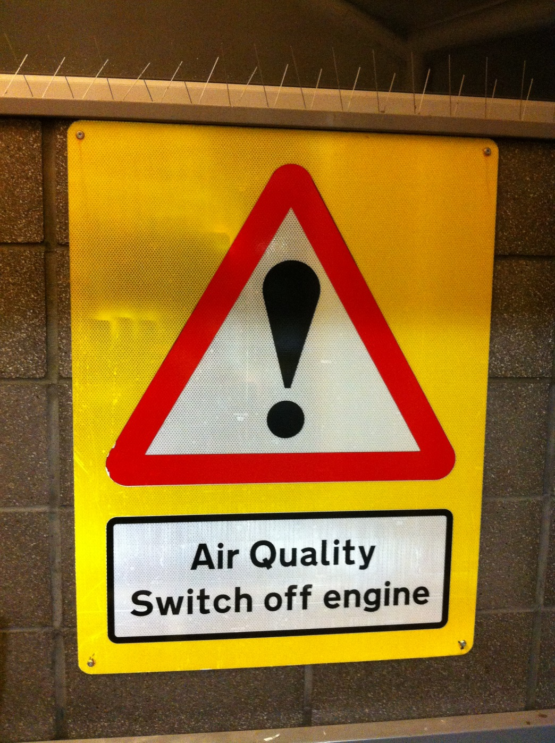
Questions and Discussion
Scope
Roles
Funding
Frequency
Systems
Reviewers
enquiries@aether-uk.com
+44(0)1865 261466
www.aether-uk.com

