Slide 1
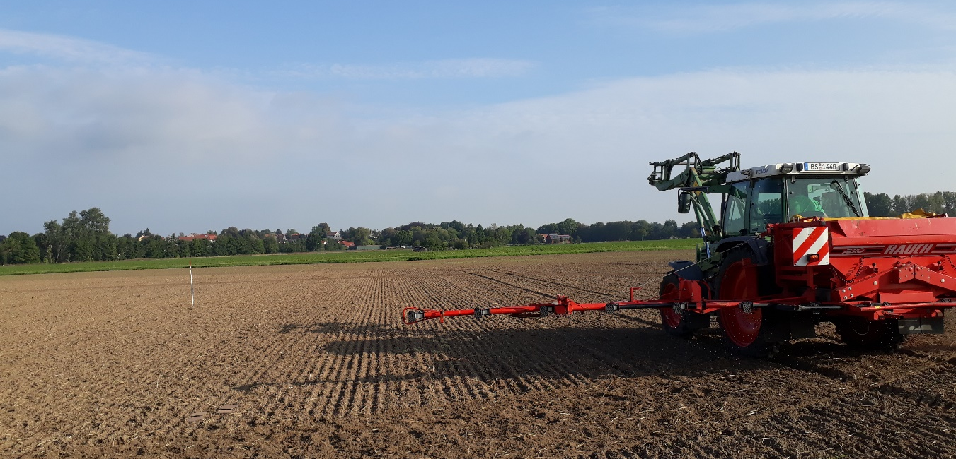
Proposal for updating the method for ammonia emission from synthetic fertilizers
Rationale and contributers
Andreas Pacholski
Thuenen Institute for Climate Smart Agriculture
TFEIP Annual Meeting Agriculture and Nature Expert Panel 11.05.2022

Slide 2
Background and development
Previous versions of method for ammonia emissions from synthetic fertilizers
  Fitted to older data set, not updated with recent data, and debated
  Reevaluation of measurement methods necessary
  More data , so can better account for influencing factors
  Mitigation measures, as e.g. inhibitors, should be reflected
  Tendency towards and call for TIER3 methodology
  Several countries feel urge to move to higher level methodologies which allow the inclusion of the effect of time and location of fertilizer application on ammonia emissions
  New broader measurement activities/campaigns:
  Reevaluation of NH₃ measurement methods, emissions and mitigation factors for synthetic fertilizers and their management (Project NH₃min, Germany)

Slide 3

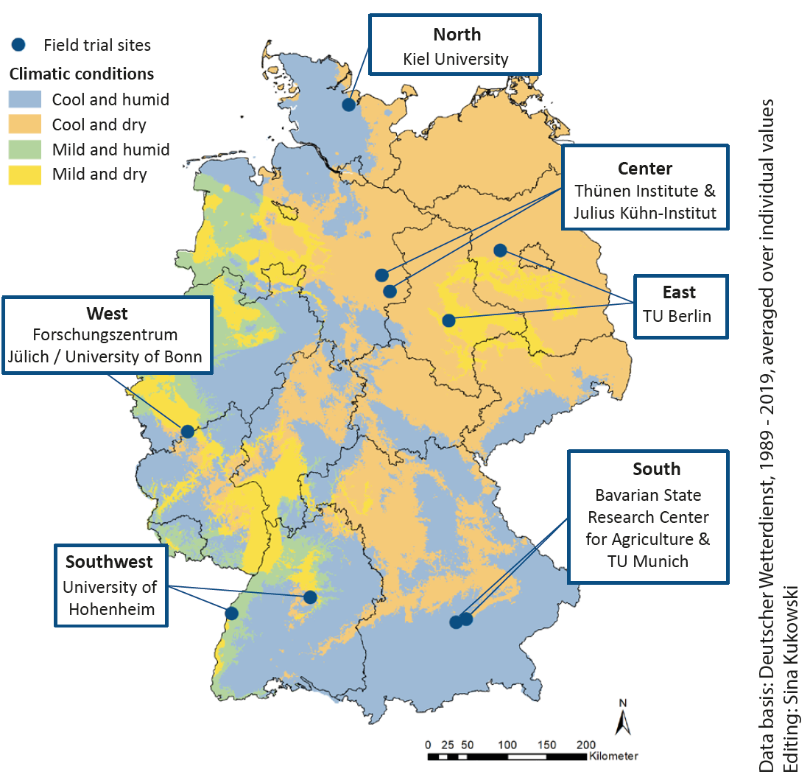
NH₃min: synthetic fertilizer field trials across Germany
6 regions in Germany: 10 experimental sites, different climates and soil types, winter wheat
Method assessment: comparison of micromet and small-plot methods
Tested fertilizers: CAN, UAN, urea, urea+UI, urea+UI+NI, UAN+UI, UAS, injected liquid Urea AS (Cultan)
Duration: 3 years (2021-2023)
Variables: NH₃-emissions, N_{min}, soil pH, crop parameters, weather, site characteristics, field management
Coordination: Thünen Institute

Slide 4
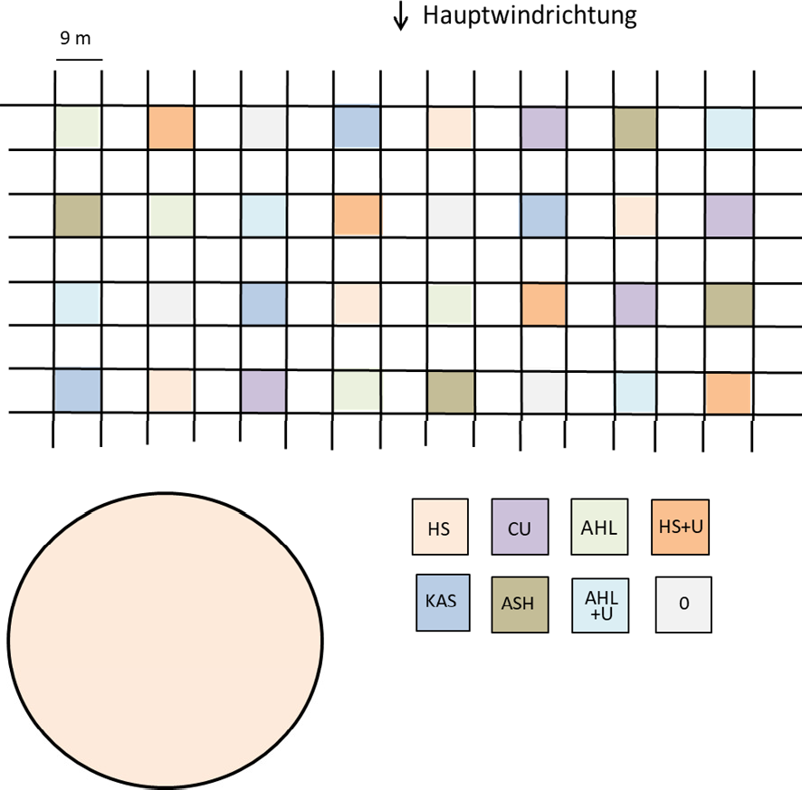
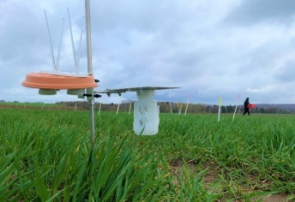
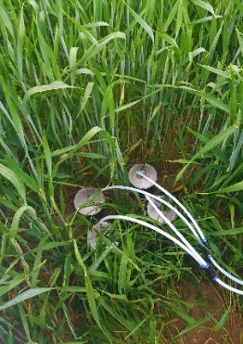
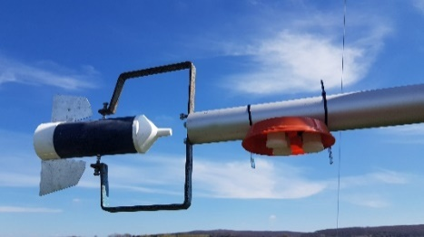
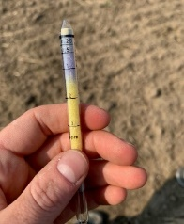
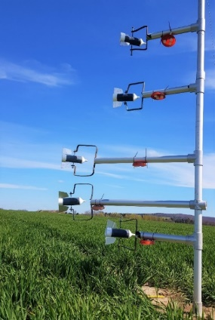
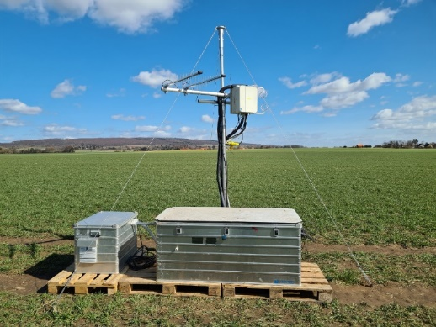
NH₃-Emission Measurements
– methods and samplers tested
Multi-plots
Plot size: 9 x 9 m
DTM (dynamic chamber)
Sulphuric acid traps
Alpha sampler
Wind tunnel (in cooperation with Aarhus University)
Circular plot (IHF, BDM)
Plot size (∅ 40 m )
DTM
Alpha sampler
Leuning sampler
Eddy Covariance with QCL (only 1 site, plot Ø 70 m)
Photos: H. Götze, S. Kukowski

Slide 5
New data and model improvement
New data
  Additional data have effect on derived emission factors
  Field data and lab incubation data need to be reassessed and categorized (methods, influencing variables)
  Model refinement and new modelling approaches: new method should reflect current level of scientific knowledge
  Frequentist modelling (exisiting methodology, addition of further explanatory variables)
  → actually mainly fertilizer type, temperature and soil pH
  Baysean modelling
  Semi-dynamic models (Tier 3)

Slide 6
Revising the Tier 2 and Tier 3 methodologies
The Tier 3 model describes emission from a single fertiliser application
  The Tier 3 method must calculate annual ammonia emissions
  The Tier 3 method will require activity data relating to the distribution of each fertiliser type in time and space
  Development of the Tier 2 methodology
  Use the Tier 3 model to develop the Tier 2 methodology
  Requires assumptions concerning the activity data.
  These assumptions need to be revisited

Slide 7
Challenges
Unbalanced data sets
  Existing experimental data are not balanced with respect to fertilizer types, fertilizer management (e.g. incorporation), availability of influencing variables and experimental conditions
  How can incubation data be involved?
  more efforts needed to identify optimal fertilizer and managemnet categories, effective and available influencing variables
  Exclude autocorrelation of influencing variables (e.g. CEC and clay content)
  Integration of effects of precipitation and/or irrigation on emissions

Slide 8
Timeline and groups involved
Time line
  End of September /early October: finalization of new draft methodology (new data collation almost completed)
  Aim to include the new methodology in the Guidebook revision
  The methodology will be published in a scientific journal
  Groups involved
  Lead: Nicholas Hutchings, Aarhus University, Denmark
  Support and cooperation: Andreas Pacholski Thuenen Institute, Germany
  Modelling advice: Roland Fuss, Thunen institute, Germany
  Contribution data refinement: Julia Jaquemotte KTBL, Germany

