Slide 1
Comparison
Tier 3 (Agrammon) and
Tier 2 (TFEIP N flow tool) for
NH₃ emission inventory livestock/manure for Switzerland 2015
EIONET/TFEIP Annual Meeting 2021 (virtual meeting)
Agriculture & Nature Expert Panel, 4th May 2021

Slide 2
Why ?
Since 1990 Switzerland used Tier 3 methodology for NH₃ emission inventory agriculture (using representative survey and N flow tool Agrammon)
In Stage 3 in-depth review 2016 reviewers suggested a comparison of the national EFs and the Guidebook EFs with a rationale of the discrepancies
To get a holistic view of the comparison between the two approaches we decided to not only compare emission factors, but compare the total inventory calculation of the two systems for NH₃

Slide 3
How ?
Comparison emission inventory 2015 for the two methodologies
  Swiss reporting based on representative survey on farm management practice relevant for NH₃ emissions and Agrammon calculations
  emep/EEA Manure Management N-flow tool calculations

Slide 4
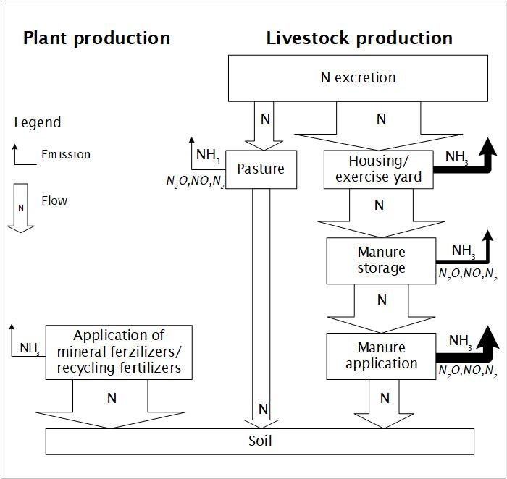
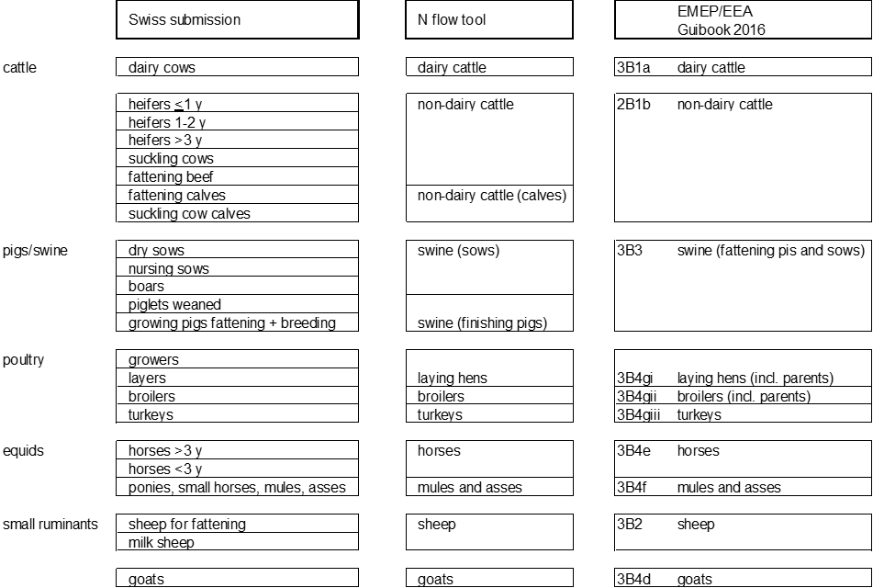
Agrammon
Agrammon N flow tool
Livestock categories
www.agrammon.ch/en/

Slide 5
Country-specific inputs for N flow tool dairy cattle (round 1)
Step 1:
  Annual animal numbers (AAP)
  Proportion tied housing system dairy cattle
  No country-specific input for “fractions for the proportion of cattle slurry stores with and without natural crusts” because not relevant in Switzerland with >80% of slurry stores with permanent cover and regular mixing during summer
Parameters:
  Proportion of slurry/solid manure stored on farm = 1
  Proportion of slurry/solid manure used for biogas = 0
  Proportion of manure deposited in houses which is "slurry”

Slide 6
Comparison dairy cattle (round 1)

Slide 7
Country-specific inputs for N flow tool dairy cattle (round 2)
Step 1:
  Annual animal numbers (AAP)
  Proportion tied housing system dairy cattle
  No country-specific input for “fractions for the proportion of cattle slurry stores with and without natural crusts” because not relevant in Switzerland with >80% of slurry stores with permanent cover and regular mixing during summer
Parameters:
  Proportions of slurry/solid stored on farms
  Proportion of slurry/solid manure stored on farm = 1
  Proportion of slurry/solid manure used for biogas = 0
  Proportion of manure deposited in houses which is "slurry”
  Housed period corrected for “days per year * h per grazing day”
  Animal weight dairy cattle

Slide 8
Comparison dairy cattle (round 2)

Slide 9
Provisional conclusions dairy cattle (after round 2)
N excretions compare well between the two approaches (for dairy cattle) in spite of different methodology
Differences between the two approaches can largely be explained, e.g.
  Higher importance slurry than solid manure
  Lower emissions housing area (tied housing cattle)
  Lower emissions yard cattle (less time and excretion on yard)
  Lower emissions slurry storage (>80% covered stores)
  Lower emissions slurry spreading (~40% low emission technique)
  Total emissions (more management technique considered)
Both grazing day and hours per grazing day must be considered

Slide 10
Provisional open questions (after round 2)
Separation of emissions liquid and solid manure in housing/yard area?
More user guidance necessary? User manual?
How far should country-specific inputs on farm management be considered in Tier 2; how far is such data usually available
What information can we get from Tier 2 on development of emissions over time?
Could the N flow model also be used as Tier 3 approach with more country-specific inputs?

Slide 11
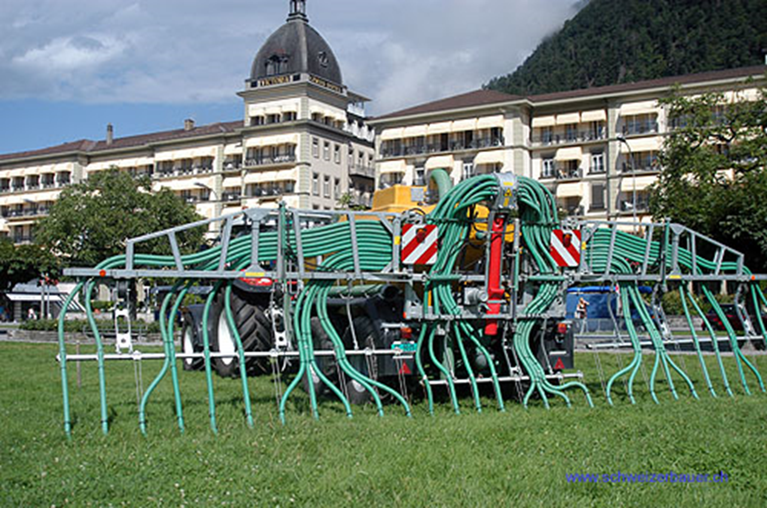

Thanks you for your attention

