Slide 1
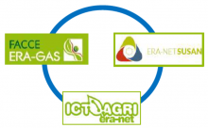
MELS – Mitigating Emissions from Livestock Systems
www.mels-project.eu
@EragasMels

Slide 2
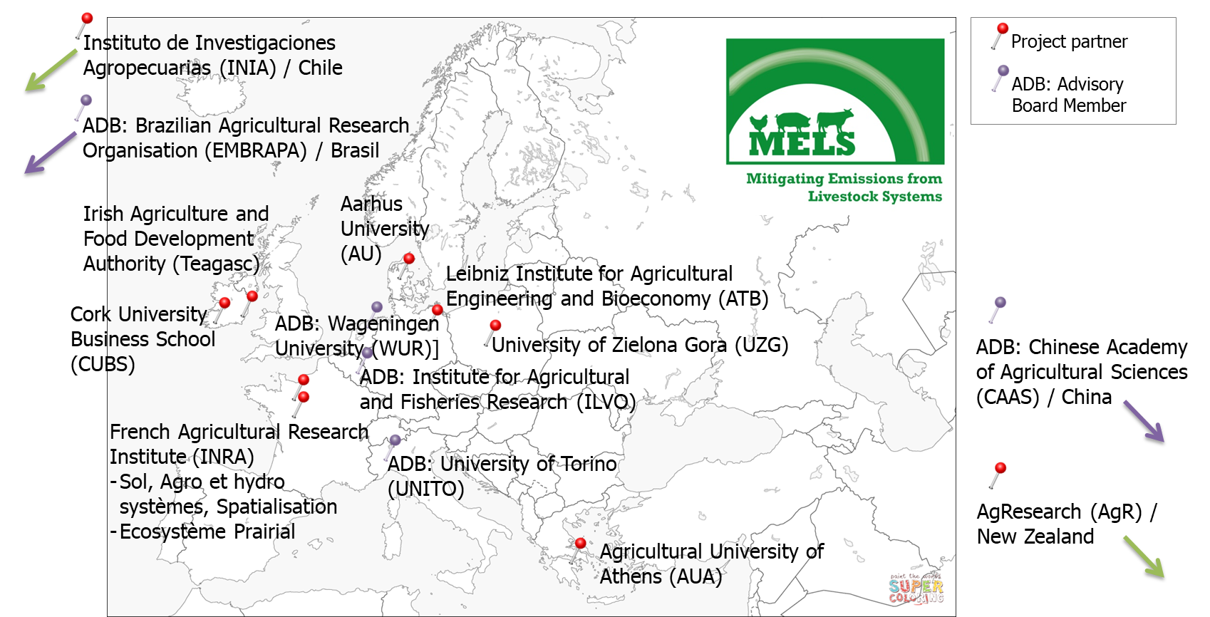
MELS consortium

Slide 3
MELS workflow
WP 5 IMPROVING NATIONAL INVENTORIES & PROJECTIONS
Assessment of
mitigation costs
and benefits
Emission factors
Integration
in national
inventories
WP 2
DATA COLLATION & MANAGEMENT
WP 3
COMPONENT MODELING
WP 4
FARM-SCALE
GHG DSS
GHG DSS
prototype
Extended
database
Functional
relationships
Stakeholders
DATAMAN
release
Stakeholder
consultation
on DSSs
WP 6 CONSULTATION & DISSEMINATION
Stakeholders
WP1 ADMINISTRATION and COORDINATION

Slide 4
WP5: Tasks and Deliverables
T5.1 Recommendations to improve inventory methodologies in partner countries
T5.2 Quantifying the costs and benefits of mitigation measures in national inventories
T5.3 Methods to obtain activity data to support emission inventories
T5.4 Retaining transparency in Tier 2+ and Tier 3 inventories
D5.1 Guidance document on recommendation for future inventory improvement (M27)
D5.2 Scientific paper on the costs and benefits of mitigation measures (M36)
D5.3 Guidance document on methods to obtain activity data to support emission inventories (M33)
D5.4 Guidance document on maintaining transparency in higher Tier inventories (M36)

